Slide 1
Chapter 1 What is deep learning?
2026 Fall
조상구교수

Slide 2
Goals
High-level definitions of fundamental concepts
A soft introduction to the principles behind machine learning
Deep learning’s rising popularity and future potential

Slide 3
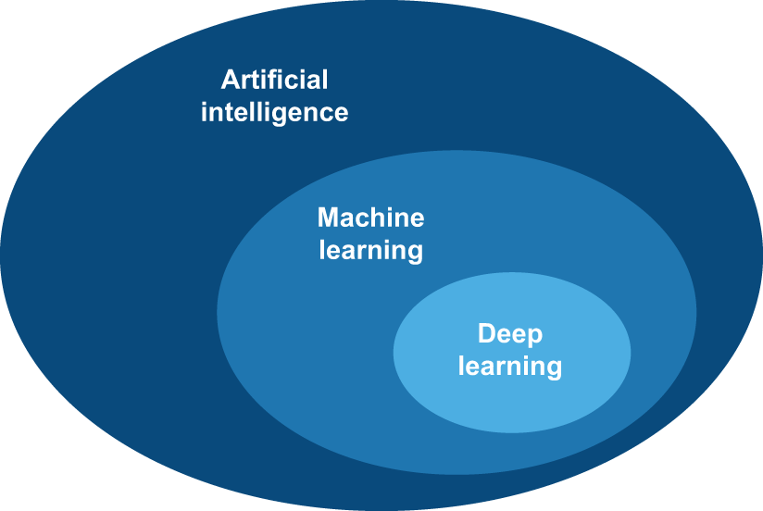
Artificial intelligence, machine learning, and deep learning

Slide 4
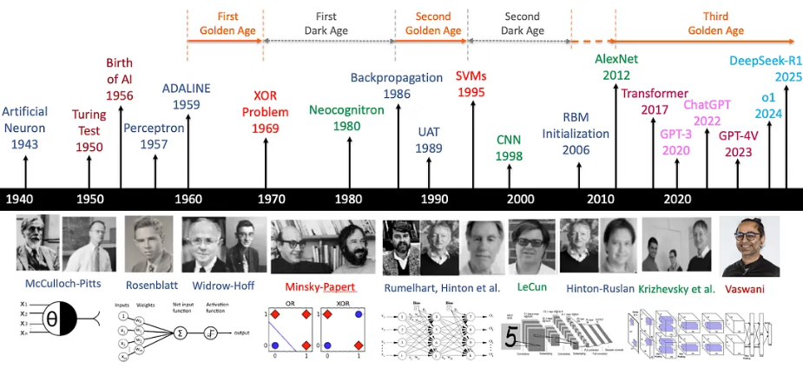
Deep Learning Timeline
A-brief-history-of-ai-with-deep-learning

Slide 5
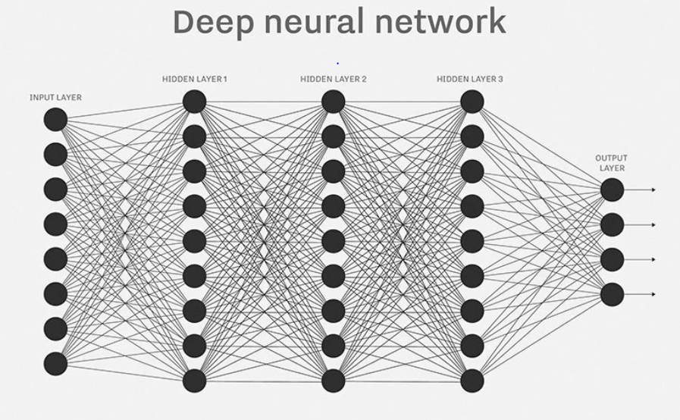



AI가 똑똑한 이유?
AI가 똑똑한 이유는 엄청난 양의 데이터(이미지, 텍스트, 사운드, 동영상)를 초고속 컴퓨터(학습 능력)로 밤낮없이 읽으면서, 입력받은 모든 데이터의 패턴을 찾아냈기 때문(수능 만점자가 기출문제를 완벽하게 마스터해서 어떤 변형 문제가 나와도 맞히는 것과 비슷)
Big Data
Computing power
Algorithm

Slide 6
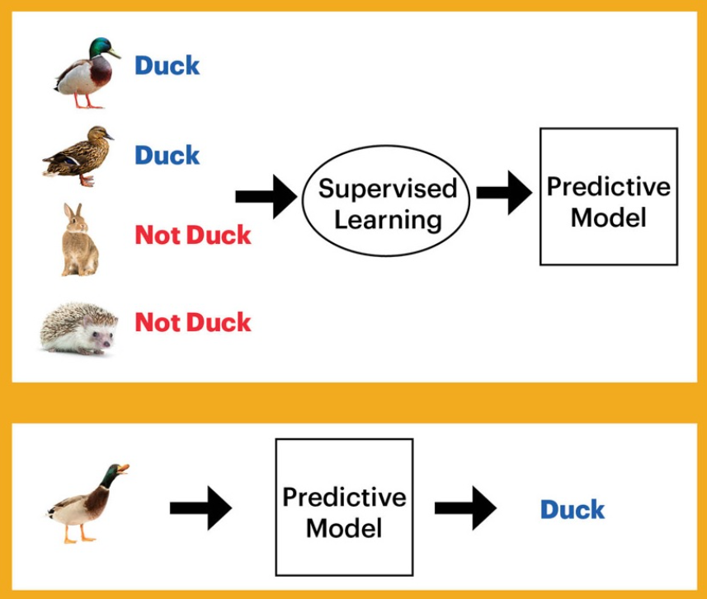
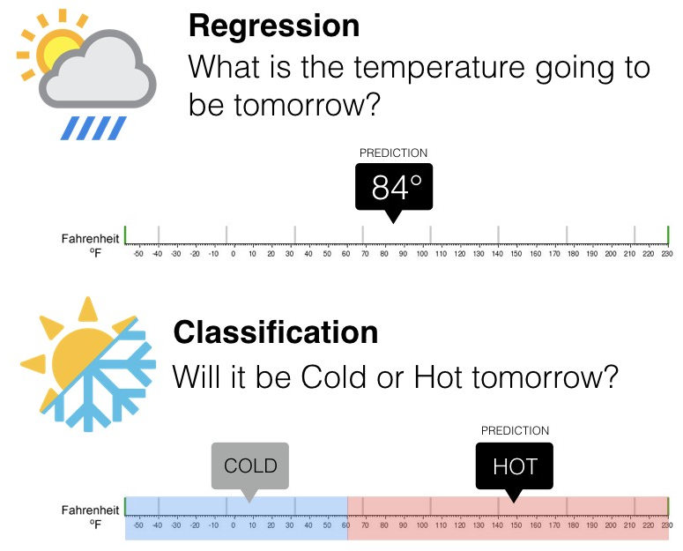
Supervised Learning(지도학습)
(회귀)
(분류)

Slide 7
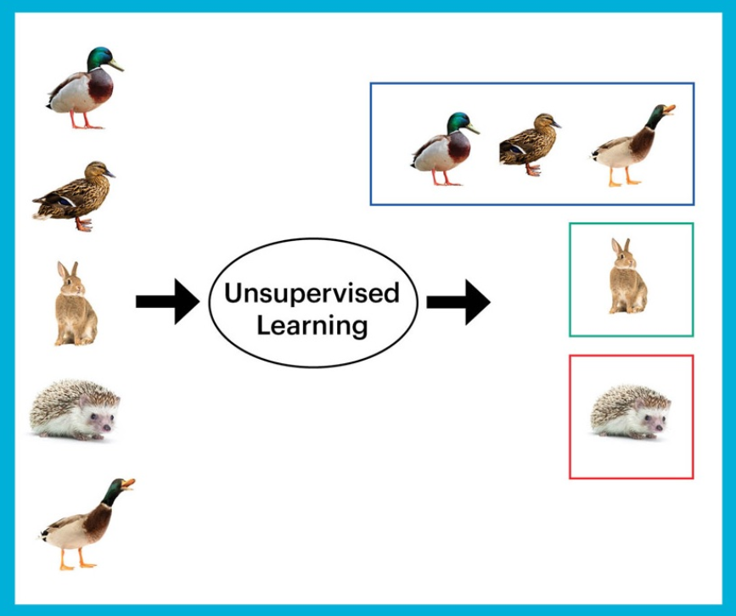
Unsupervised Learning(비지도학습)
Cluster(군집)

Slide 8
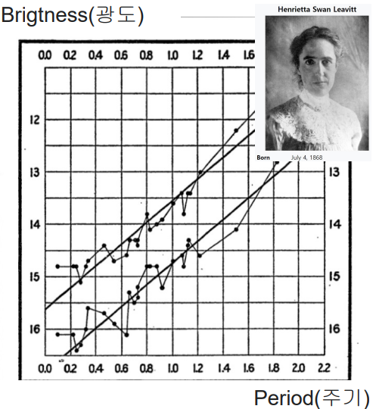
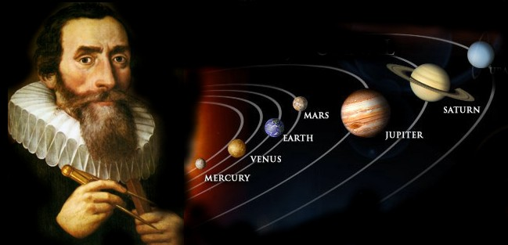
Human Learning
머신러닝이전 시대에는 관측된 데이터에 존재하는 규칙성(Patterns)을 사람이 직접 궁리하고 발견하여 새로운 데이터를 예측 (귀납법)
방대하고 정밀한 데이터들을 직접 수년간 궁리하고 계산(귀납법)한 끝에, 행성이 원이 아닌 '타원 궤도'로 공전한다는 규칙성을 발견
변광성의 밝기가 변하는 '주기'와 실제 별의 '밝기(광도)' 사이에 일정한 선형적 관계(패턴)를 발견

Slide 9

Machine learning
과거 데이터에 존재하는 규칙성(Patterns)을 컴퓨터가 발견하게 하여 새로운 데이터를 예측하는 것이 Machine Learning (New Paradigm)
Rules
Classical
Programming
Answer
Data
Answer
Machine
Learning
Rules
Data

Slide 10
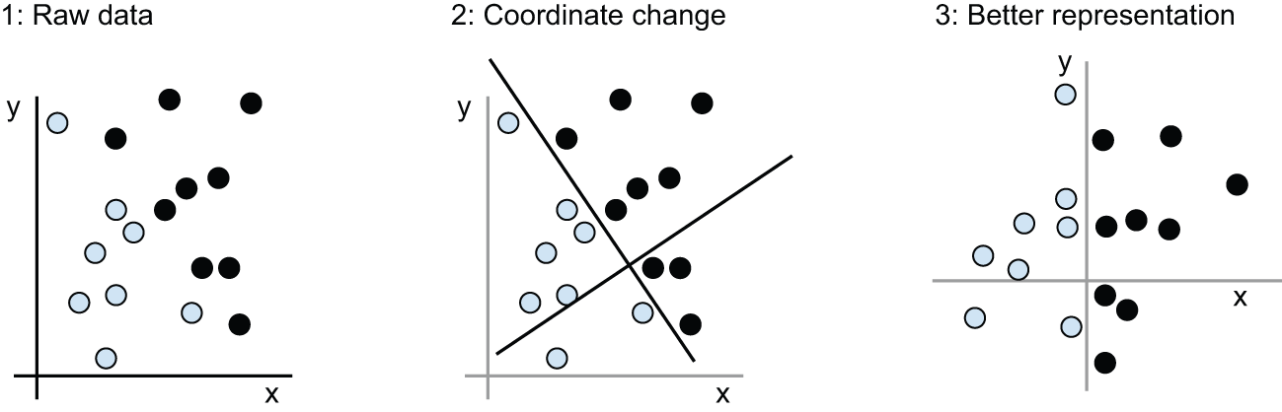
Learning rules and representations from data

Slide 11
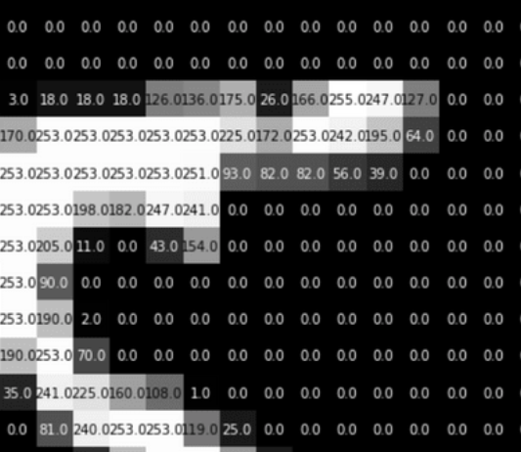
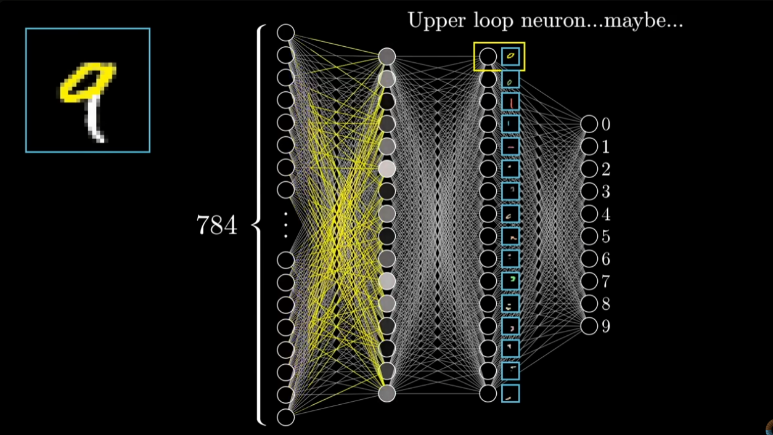
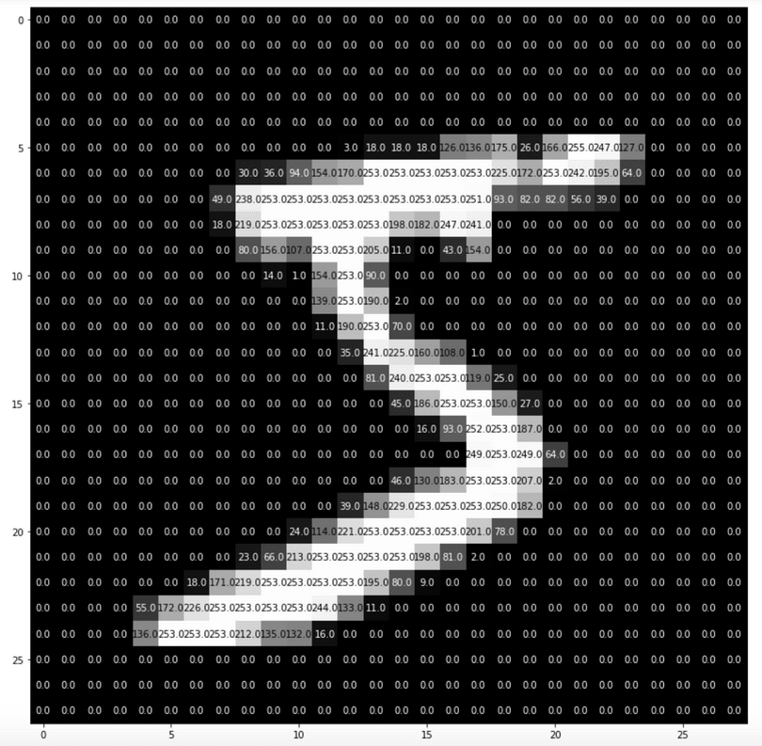
11
What is a deep learning?
28 x 28 pixel
784 pixel
What is a neural network?(start= 3 min, end = 5 min)

Slide 12

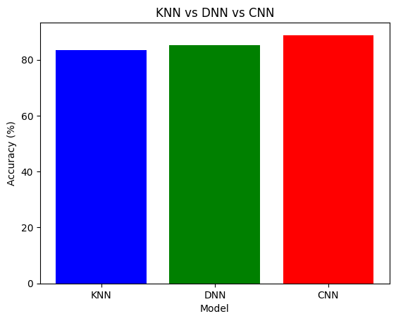
12
scikit-learn vs. deep learning
Fashion_minst 데이터를 바탕으로 KNN, FNN(Feed Forward Neural Networks), CNN(Convolutional Neural Networks)의 성능을 비교하자
2026_Fall_Deep-Learning-with-Python/scripts/00_sklearn_keras.ipynb
from tensorflow.keras.datasets import fashion_mnist
# 1. MNIST 데이터 로드
(x_train_full, y_train_full), (x_test_full, y_test_full) = fashion_mnist.load_data()
# 2. 50%만 슬라이싱
n_train = int(len(x_train_full) * 0.5)
n_test = int(len(x_test_full) * 0.5)

Slide 13
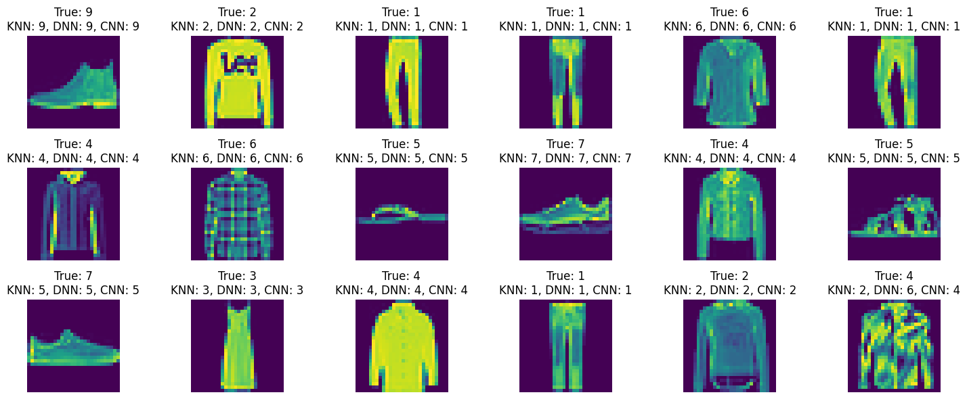
13
scikit-learn vs. deep learning

Slide 14
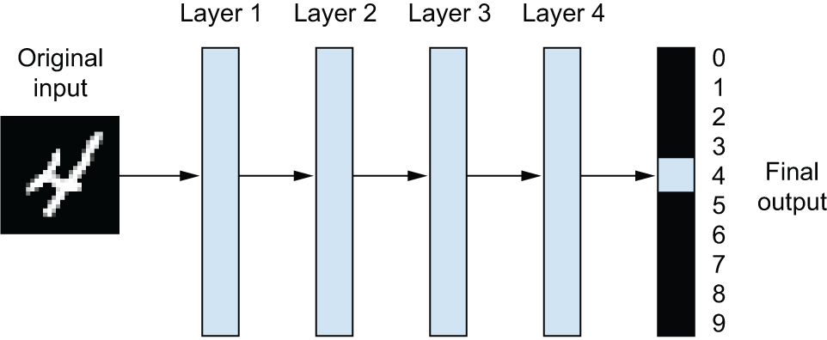
The “deep” in “deep learning”
A deep neural network for digit classification

Slide 15
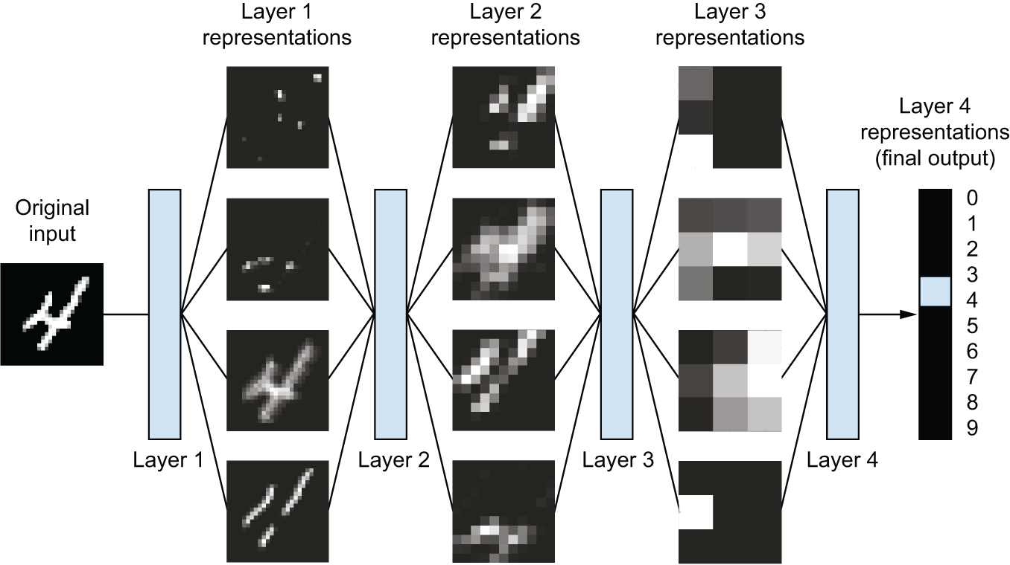
The “deep” in “deep learning”
Deep representations learned by a digit-classification model

Slide 16
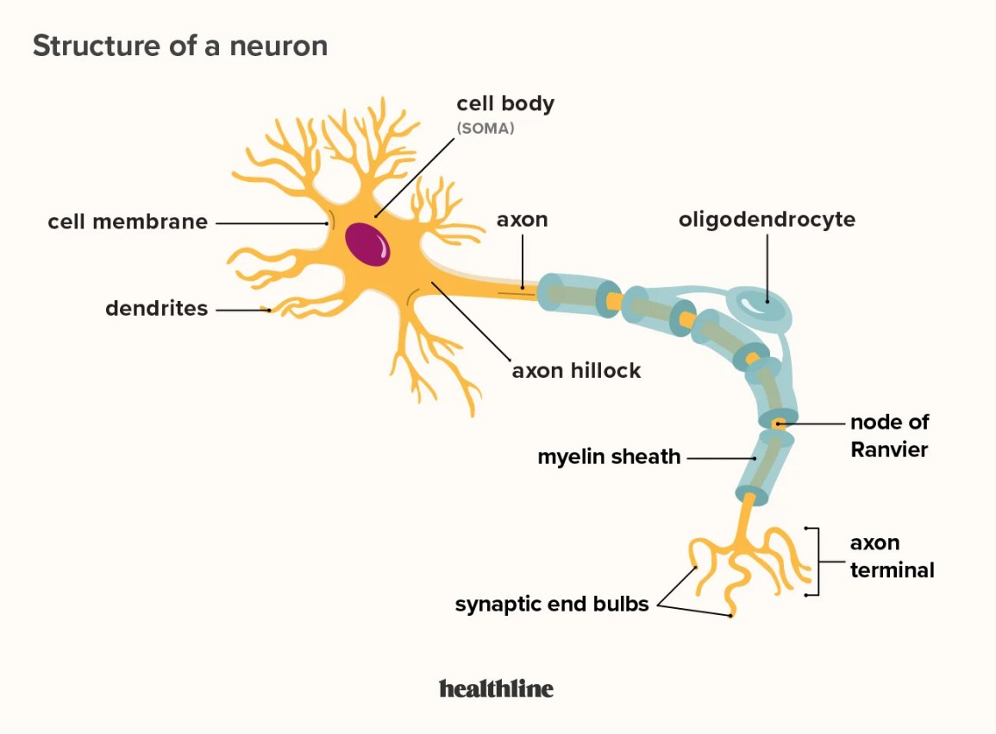
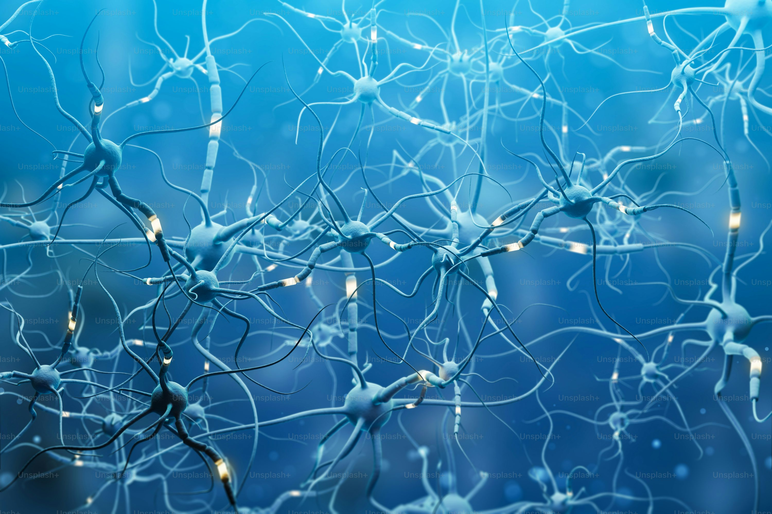
16
16
16
16
16
16
16
16
16
Human Neurons ?
https://unsplash.com/

Slide 17
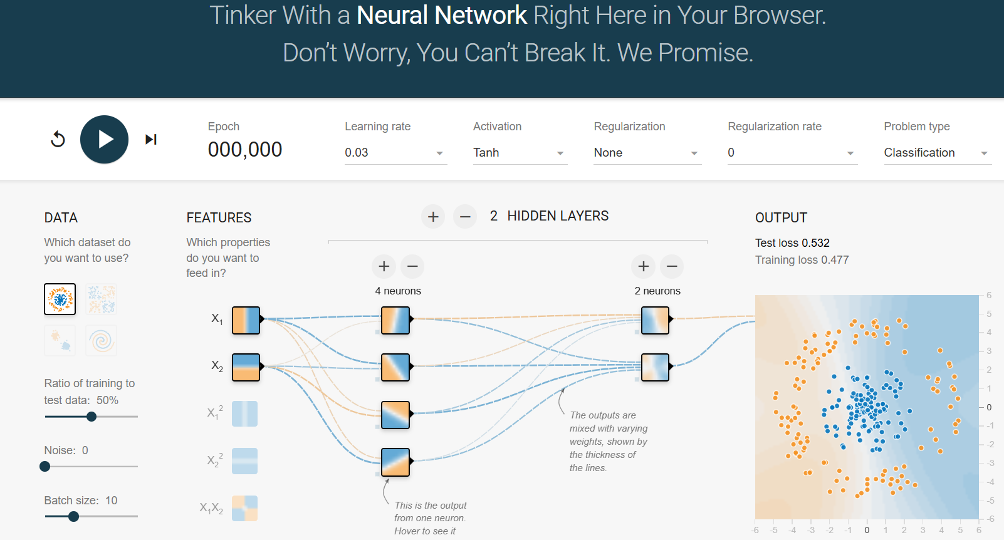
17
실습하기
https://playground.tensorflow.org/

Slide 18
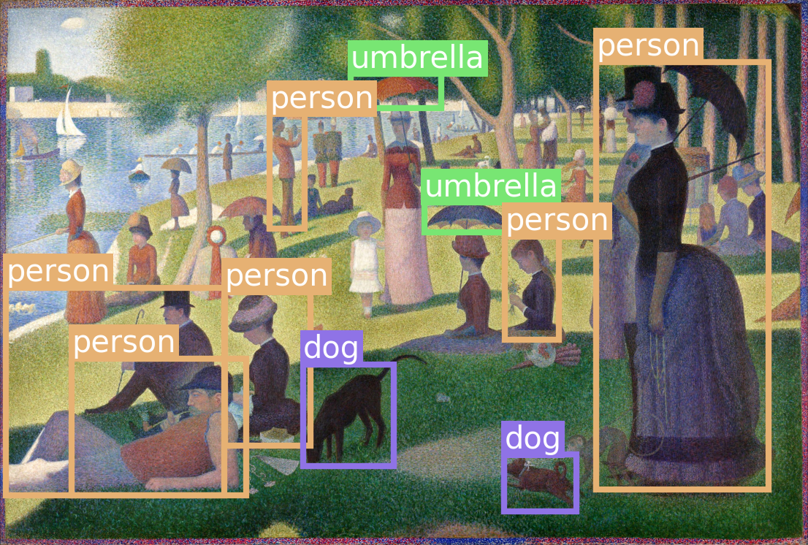
18
object recognition
How computers learn to recognize objects instantly
https://transcranial.github.io/keras-js/#/

Slide 19
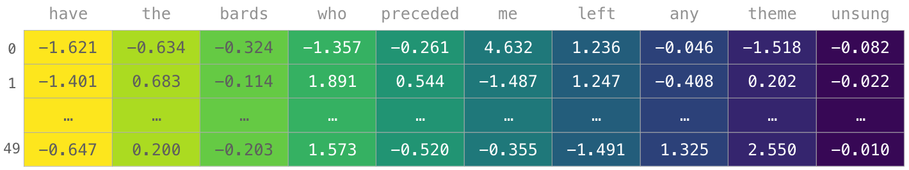
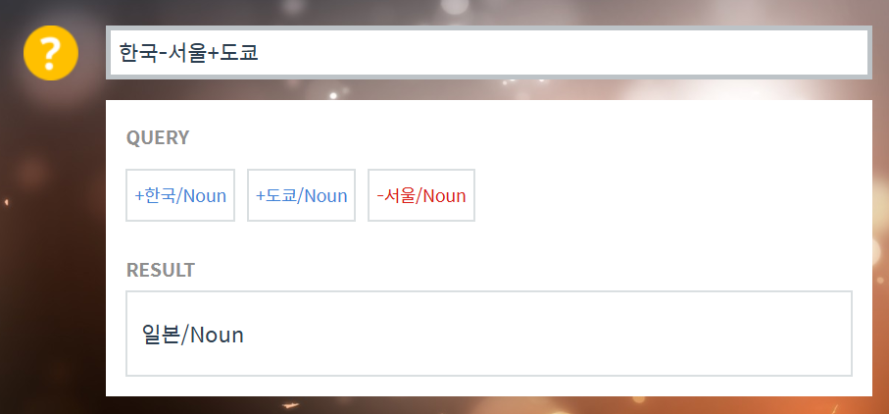
실습하기
Word Embedding
https://word2vec.kr/search/
한국-프랑스+파리

Slide 20
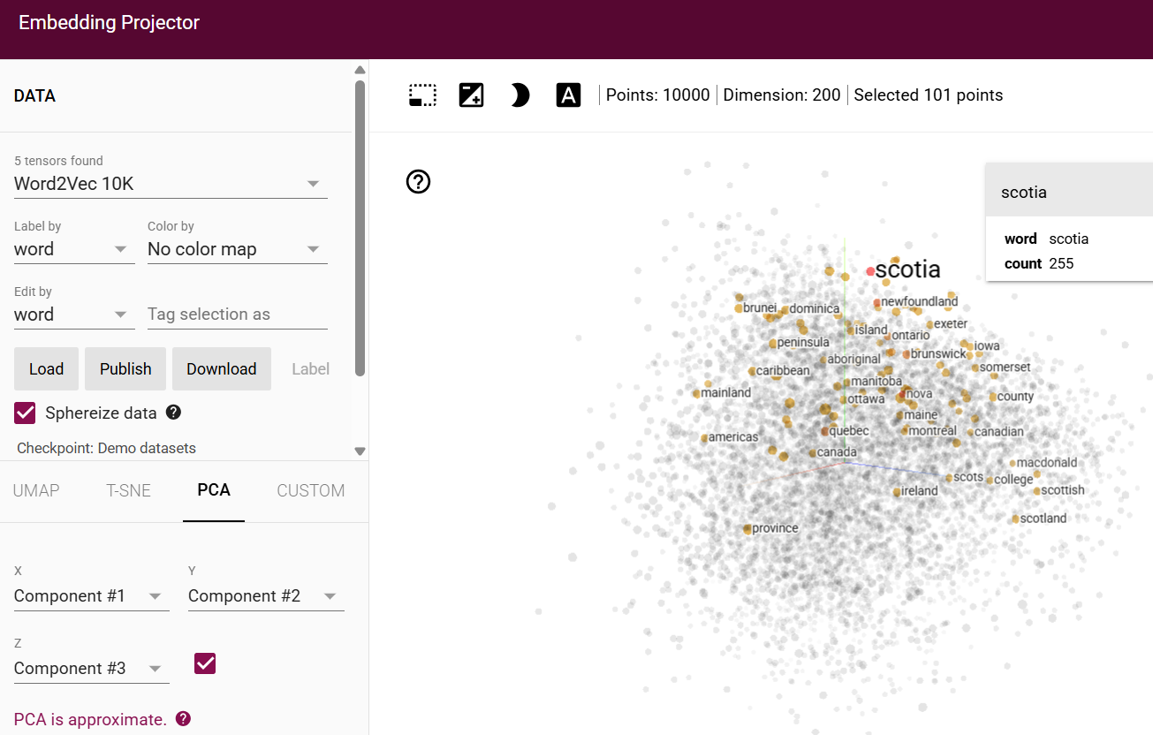
실습하기
tensorflow_projector

Slide 21
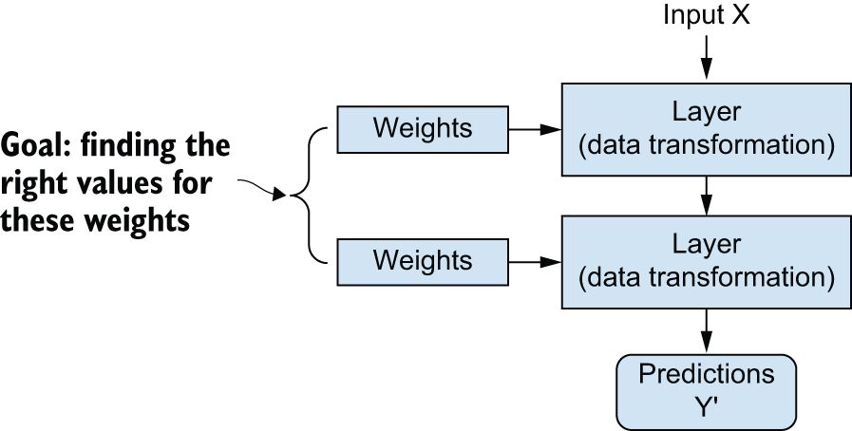
Understanding how deep learning works, in three figures
A neural network is parameterized by its weights.

Slide 22
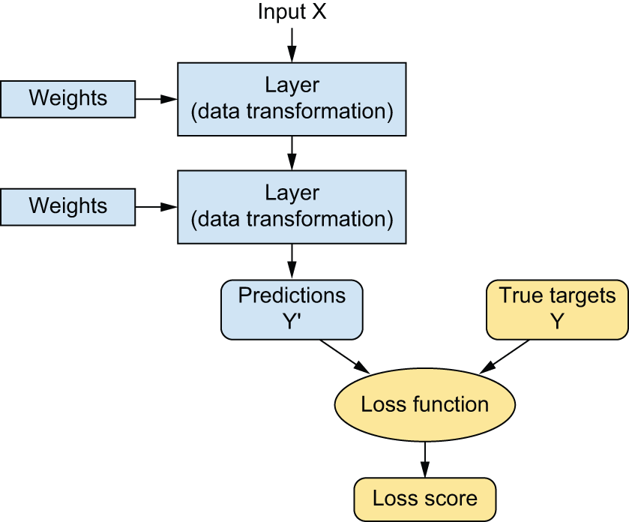
Understanding how deep learning works, in three figures
A loss function measures the quality of the network’s output.

Slide 23
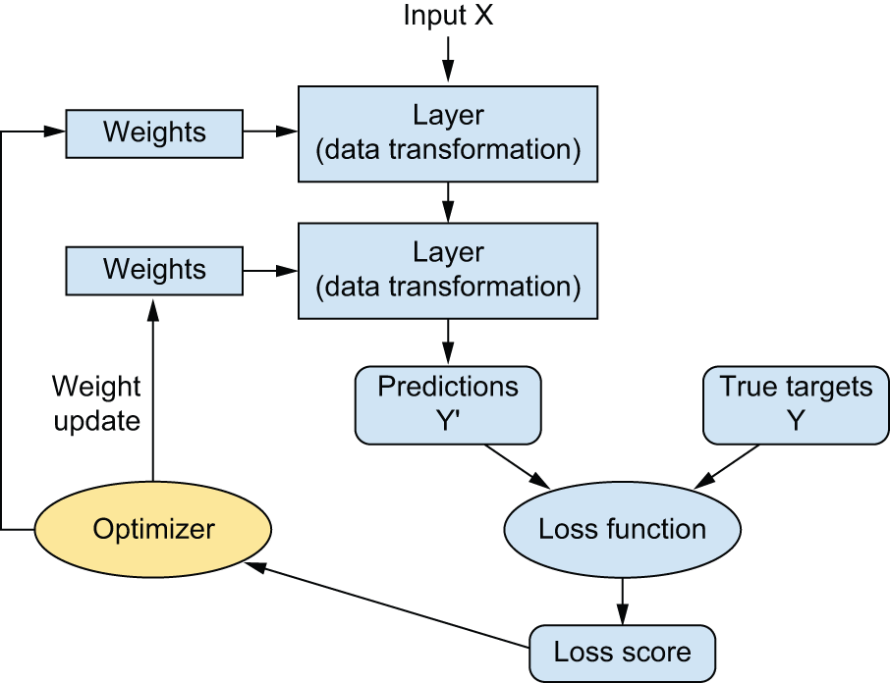
Understanding how deep learning works, in three figures
The loss score is used as a feedback signal to adjust the weights.

Slide 24
What makes deep learning different
Simplicity
To make problem solving much easier, because it automates what used to be the most crucial step in a machine learning workflow: feature engineering.
To completely automate feature engineering step, which has greatly simplified machine learning workflows, often replacing sophisticated multistage pipelines with a single, simple, end-to-end deep learning model.
Scalability
To be highly amenable to parallelization on GPUs or more specialized machine learning hardware
Versatility and reusability
To be trained on additional data without restarting from scratch, making them viable for continuous online learning — an important property for very large production models.
To be repurposable and thus reusable: this is the big idea behind “foundation models” — large models trained on humongous amounts of data, which can be used across many new tasks with little retraining, or even none at all.

Slide 25

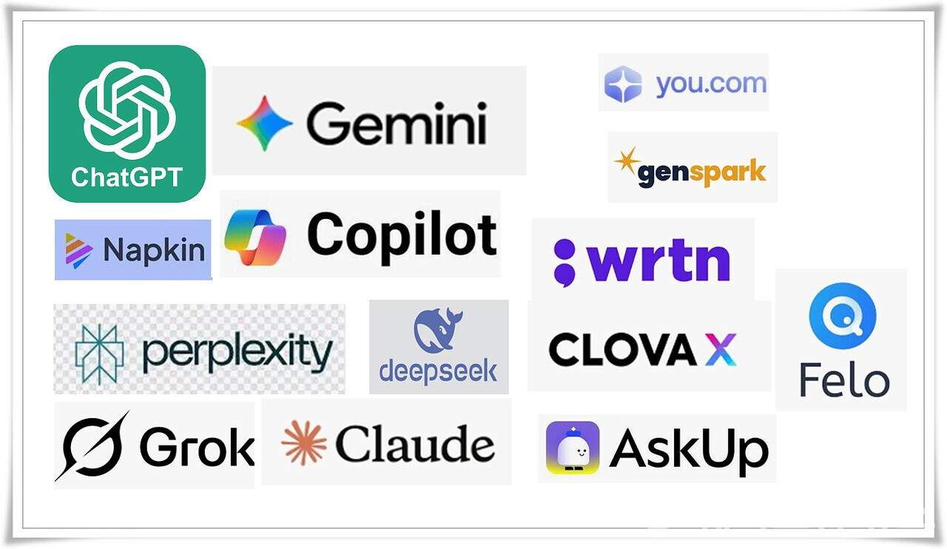
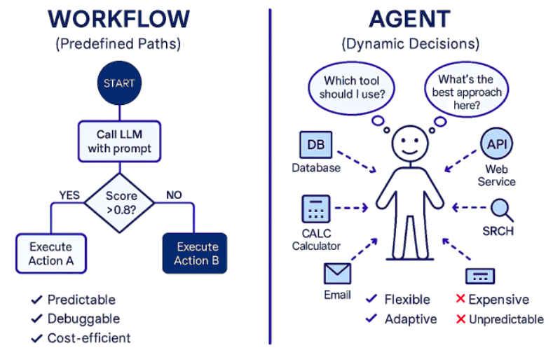
The age of generative AI
2025년 생성형 AI
2026년 AI Agent

Slide 26
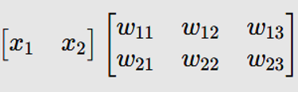
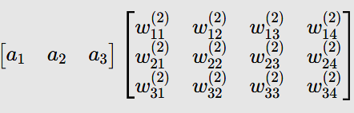
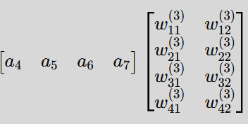
FCCN : Matrix Formulation
Fully Connected Neural Network (FCNN) 구조를 행렬식으로 표현 :
Input(X)
Hidden Layer 1
Hidden Layer 2
Output(y)
(1,2) @ (2,3) = (1,3)
(1,3) @ (3,4) = (1,4)
(1,4) @ (4,2) = (1,2)

Slide 27
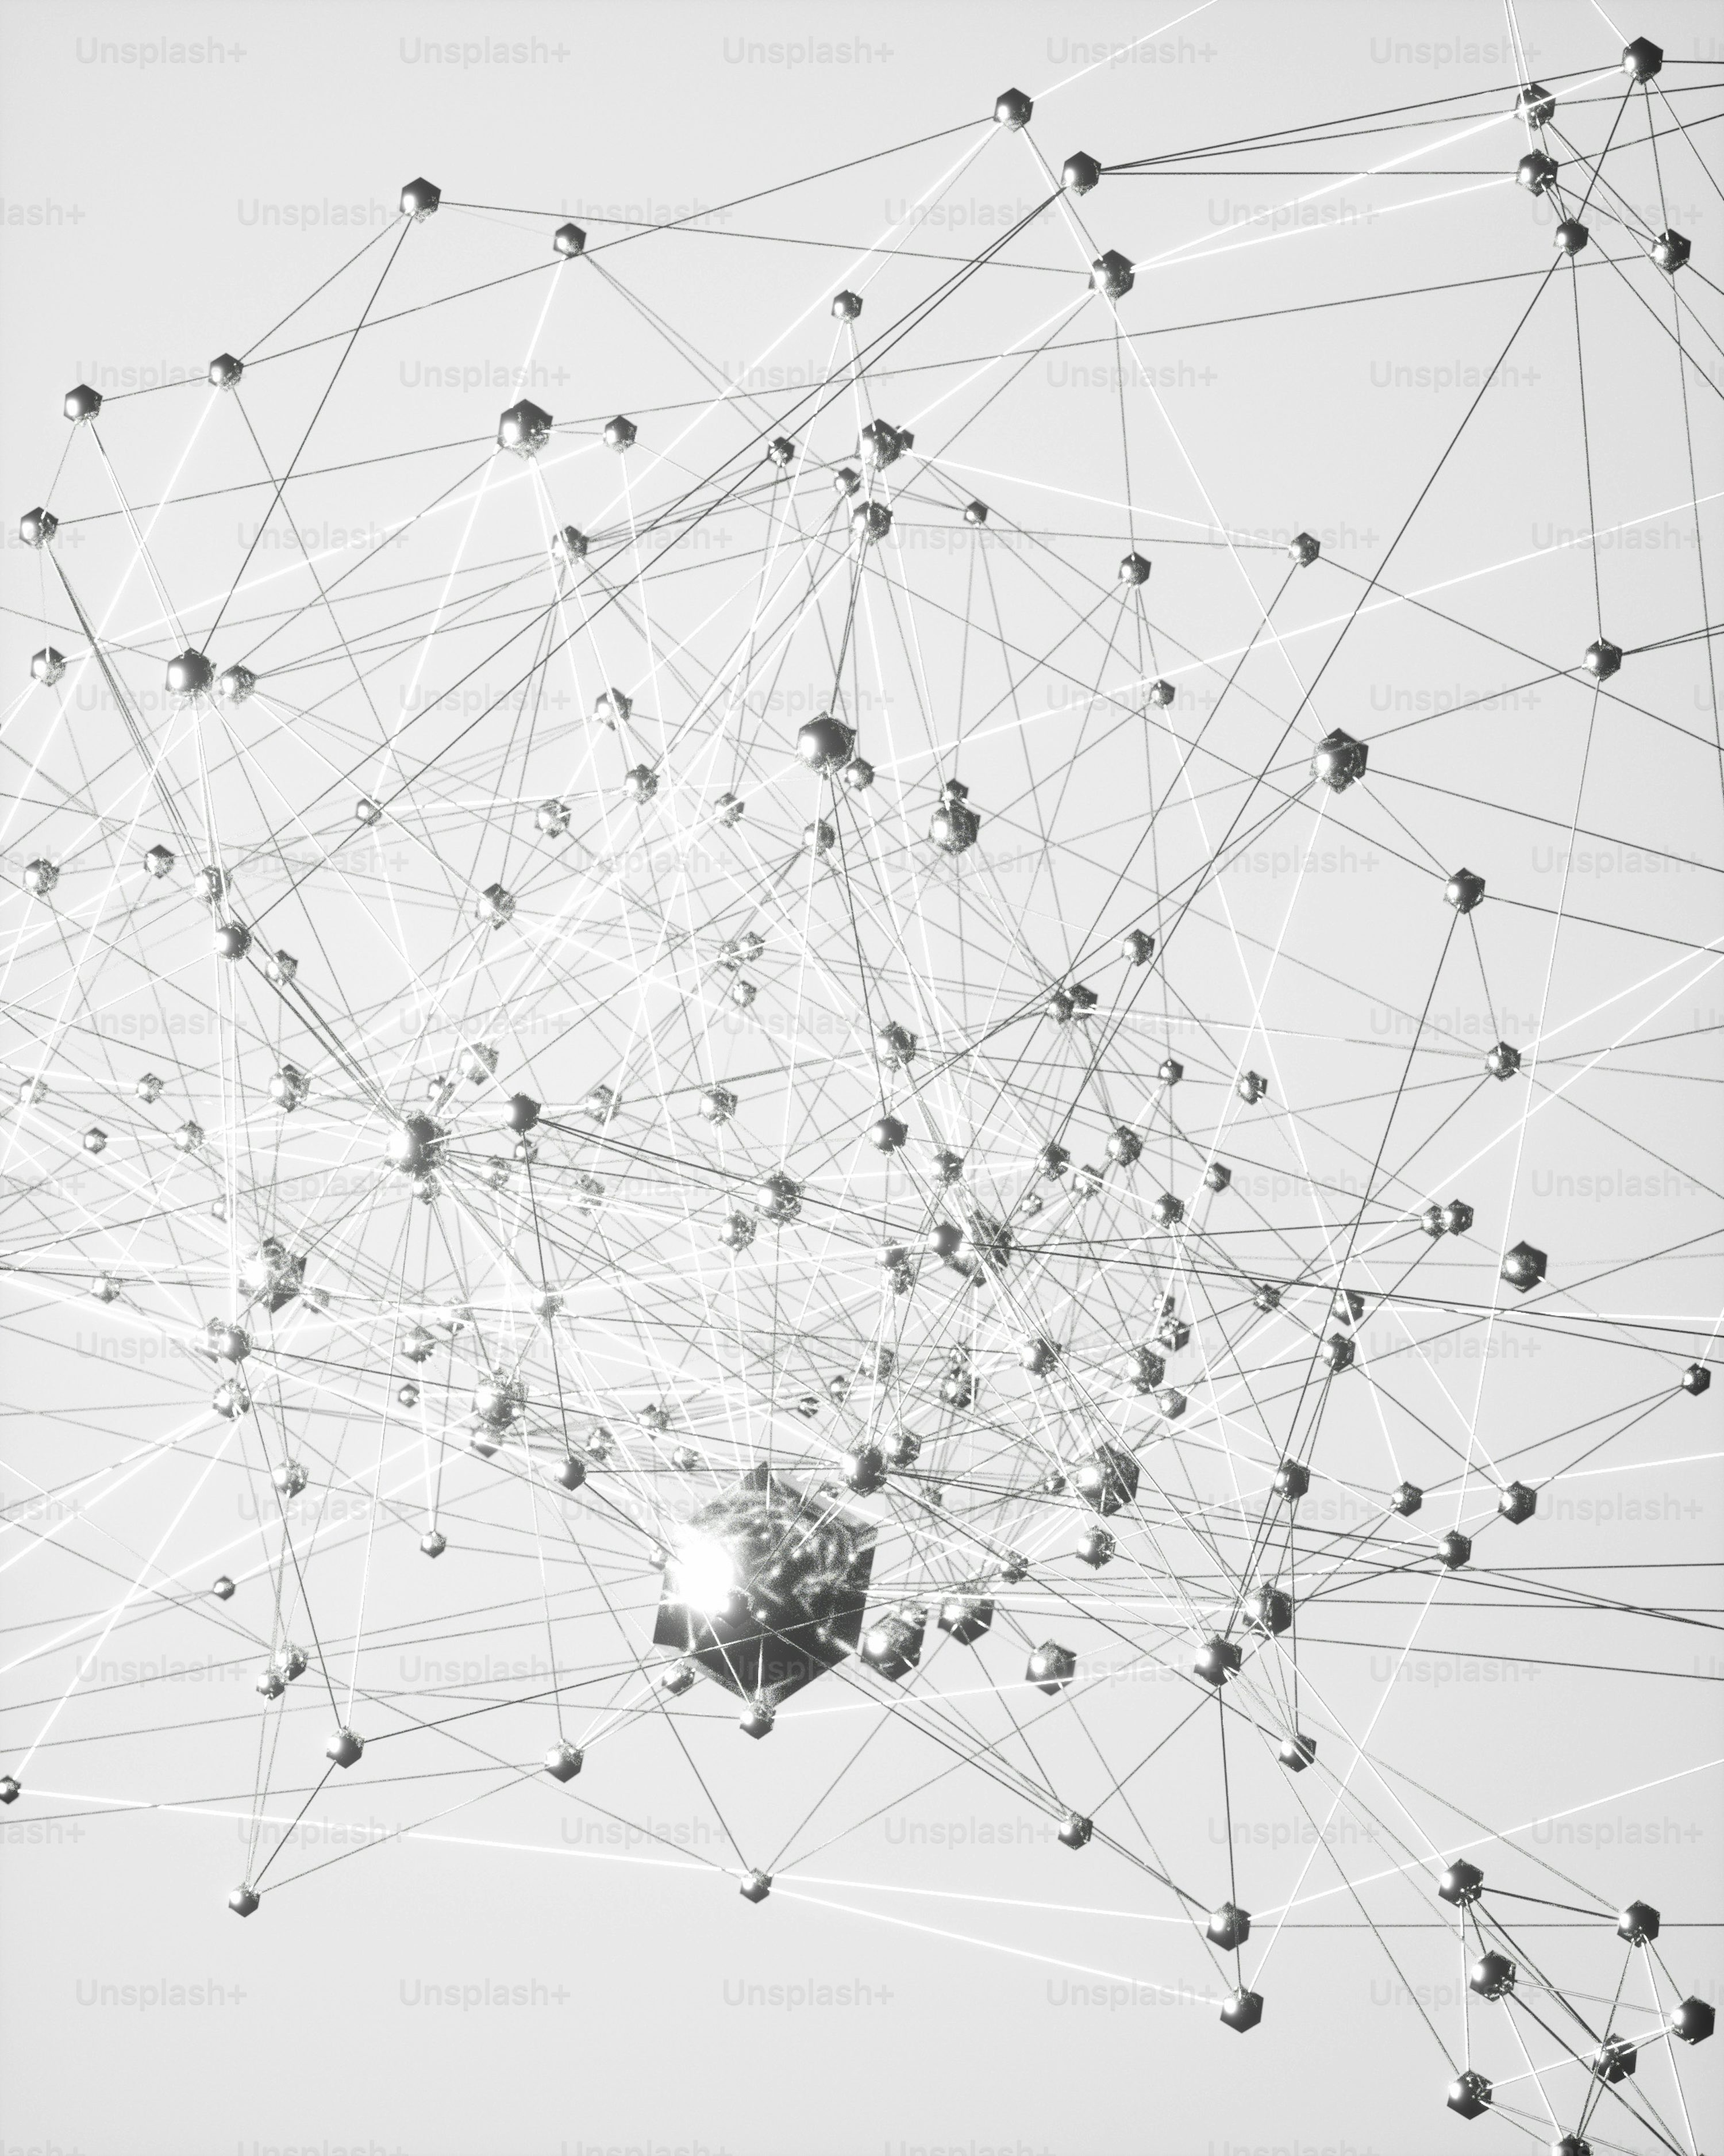
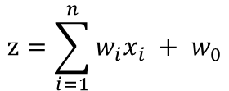

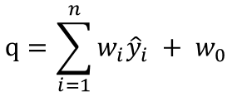

FCNN Architecture
Input (28 * 28)
Weights
Layer (Dense =512)
Weights
Layer (Dense =10)
Weighted Sum
Activation function
(Relu)
Weighted Sum
Activation function
(Softmax)
$$z=\sum_{i=1}^{n}{w_{i}x_{i} + w_{0}}$$
$$q=\sum_{i=1}^{n}{w_{i}{\hat{y}}_{i} + w_{0}}$$
$$\hat{y}=σ\left(z\right)$$
$$\hat{k}=σ\left(q\right)$$

Slide 28

Keras Hands-on : classification
from keras.datasets import mnist
(train_images, train_labels), (test_images, test_labels) = mnist.load_data()
import keras
from keras import layers
model = keras.Sequential([layers.Dense(512, activation="relu"),
layers.Dense(10, activation="softmax"),]
)
model.compile(
optimizer="adam",
loss="sparse_categorical_crossentropy",
metrics=["accuracy"],
)
model.fit(train_images, train_labels,
epochs=5,
batch_size=128)

Slide 29
scikit-learn Hands-on : classification
from sklearn.datasets import fetch_openml
from sklearn.neural_network import MLPClassifier
# 1. 데이터 로드 및 전처리 (2D 이미지를 1D 평탄화 + 0~1 정규화)
X, y = fetch_openml("mnist_784", version=1, return_X_y=True, as_frame=False)
train_images, train_labels = X[:60000] / 255.0, y[:60000].astype(int)
# 2. 모델 생성 (1개 은닉층, 512개 노드, ReLU 활성화함수)
model = MLPClassifier(
hidden_layer_sizes=(512,), # Dense(512)에 대응
activation="relu", # activation='relu'
solver="adam", # optimizer='adam'
batch_size=128, # batch_size=128
max_iter=5, # epochs=5
random_state=42,
)
# 3. 모델 학습
model.fit(train_images, train_labels)

Slide 30
scikit-learn Hands-on : classification
from scipy.stats import randint # 확률분포를 사용하여 여러 가능성 탐색
from sklearn.ensemble import RandomForestClassifier
from sklearn.model_selection import RandomizedSearchCV
# 1. 데이터 로드 (학습 속도를 위해 10,000개 샘플 사용)
X, y = fetch_openml("mnist_784", version=1, return_X_y=True, as_frame=False)
X_train, y_train = X[:10000], y[:10000].astype(int)
# 2. 하이퍼파라미터 탐색 범위 설정 (연속적/넓은 범위 설정 가능)
param_dist = {
"n_estimators": randint(50, 300), # 50~300 사이의 무작위 정수
"max_depth": [10, 20, 30, None], # 트리의 최대 깊이
}
# 3. RandomizedSearchCV 객체 생성 (10개 조합 무작위 추출 x 3-Fold CV = 총 30회 학습)
rf = RandomForestClassifier(random_state=42) # Bootstrap sampling 과 특성(Feature) 선택의 무작위성
random_search = RandomizedSearchCV(
estimator=rf,
param_distributions=param_dist,
n_iter=10, # 시도할 무작위 조합의 개수
cv=3, # 3겹 교차 검증
scoring="accuracy",
n_jobs=-1, # 모든 CPU 코어 활용
random_state=42,
verbose=1,
)
# 4. 하이퍼파라미터 무작위 탐색 및 교차 검증 실행
random_search.fit(X_train, y_train)
# 5. 최적 파라미터 및 최고 검증 점수 확인
print("최적 하이퍼파라미터:", random_search.best_params_)
print(f"최고 교차 검증 정확도: {random_search.best_score_:.4f}")
# 6. 학습된 최적 모델 추출
best_model = random_search.best_estimator_

Slide 31
Home work
아래 코드로 Keras 실습하고 제출하기
https://github.com/ancestor9/mathematics-for-machine-learning/blob/main/scripts/Introduction_to_deep_learning.ipynb
Feedforward, Backward, autograd, stochastic gradient descent, optimizer, neuron, layer, loss function
FCNN vs. CNN 이 입력변수(Features)를 인식하는 방법의 차이점을 설명할 수 있나?

